Slide 1






Lights, Camera, Earnings: What Drives the Show Biz?
Team 7: Divyam Rana, Achinthya Sreedhar, Neha Shastri, Wenlin Zhao, Xingzhu Chen, Atishay Jain

Slide 2
Table of Contents
01
02
03
04
Introduction
Executive Summary
Data Cleanup & Mapping
EDA & Dashboards
Conclusion
Challenges

Slide 3





01
Introduction

Slide 4

WHAT are we going to talk about?
Fierce Competition: Requires innovative strategies to stand out
Audience Understanding: Essential for creating impactful content
Data-Driven Insights: Needed to understand movie success metrics (ratings, revenue, genre trends)

Slide 5
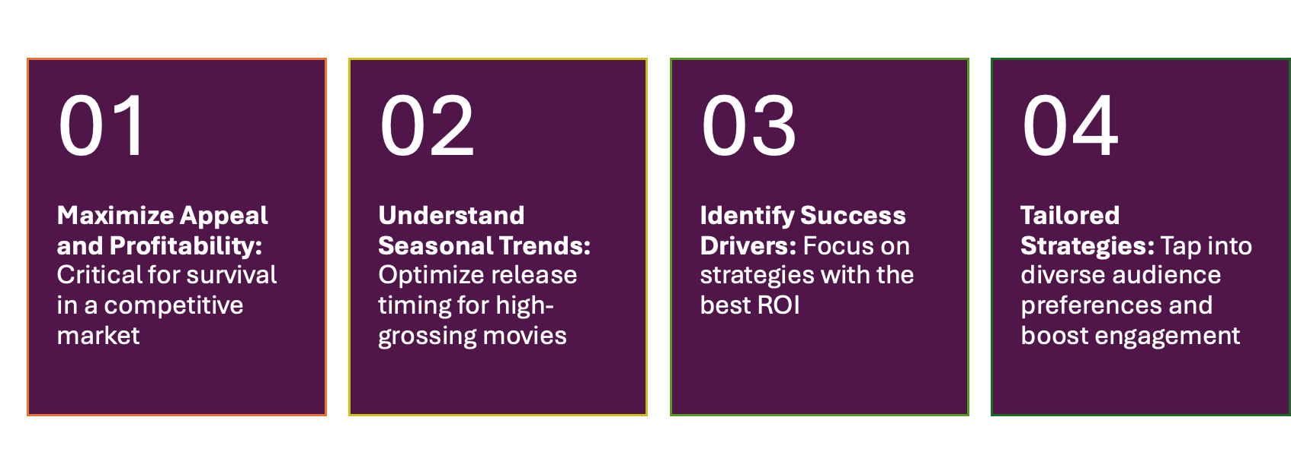
WHY is this relevant?

Slide 6
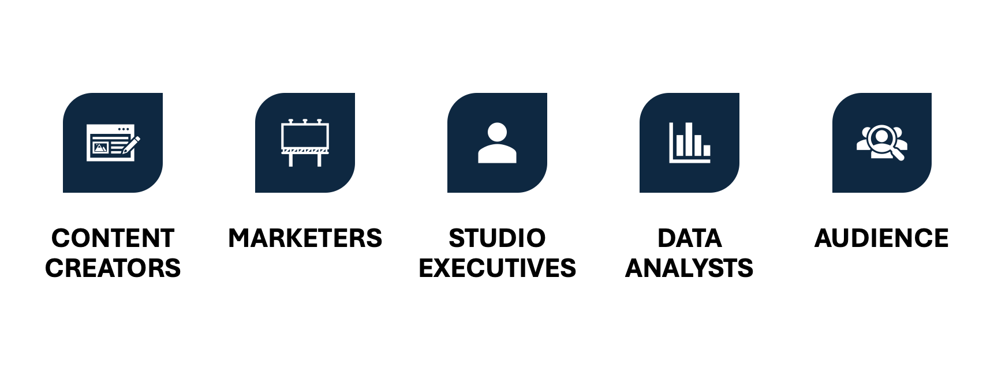
WHO are the stakeholder?

Slide 7
Executive Summary
Summary
Analyzed the IMDB dataset
Explored the factors of successful movies and entertainment media
Identified the key trends in the show biz
Insights
Comedy, Drama, and Documentary are most produced
Action, Adventure, and Animation tend to perform better
High-grossing films often release in peak seasons: June and December.
Telugu films and specific titles like Pirates of the Caribbean show regional popularity (like in Caribbean)
Headwinds
JSON type objects in dataset
Type Inaccuracies
Missing Values

Slide 8
02
Data Cleanup & Mapping

Slide 9
Datasource
IMDb Non-Commercial Datasets
Movie Box Office Revenue
Data Types: String , Integer, Float, DateTime, JSON
Notes:
A collection of comprehensive, regularly updated datasets from IMDb, covering movie and TV show metadata for non-commercial use.
Movie Box Office Revenue Prediction Dataset: A curated dataset from Mendeley containing features like budgets, genres, and cast, designed for predicting movie box office revenue.

Slide 10
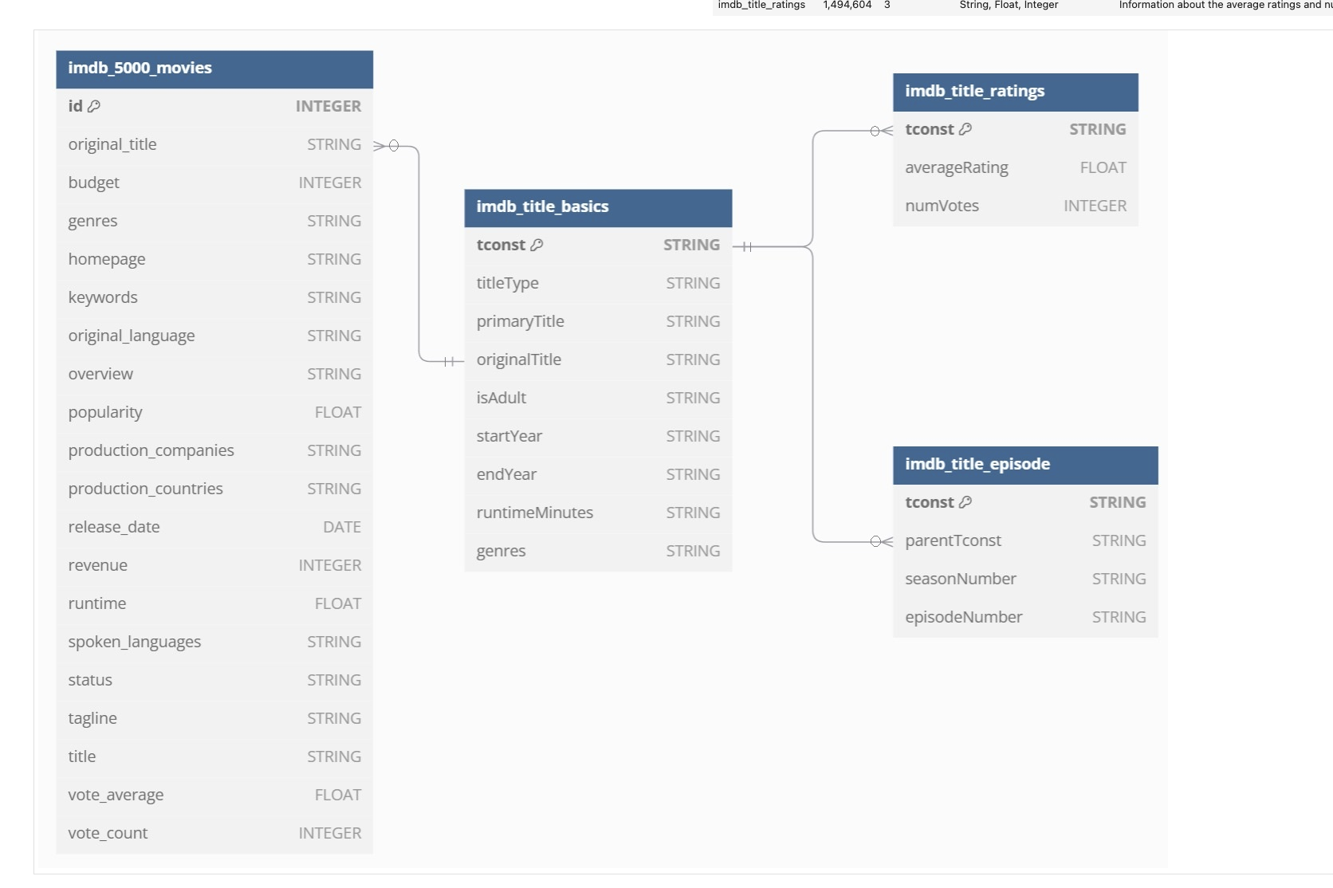
Entity Relationship Diagram
Notes:
The tables imdb_5000_movies and imdb_title_basics are connected through ‘originalTitle and the imdb_title_ratings imdb_title_episode are connected through the 'tconst' identifier.
Enables efficient cross-referencing of movie/show information.
Supports data integrity across the database.

Slide 11
Data Cleaning and Preparation
Created Views to obtain a clean interface for analysis and reporting by organizing, filtering, and combining datasets.
Converted numeric fields in ideal formats for consistency.
Mapped original_language codes to readable names.
Applied thresholds for relevance wherever required.

Slide 12
03
EDA & Dashboards

Slide 13
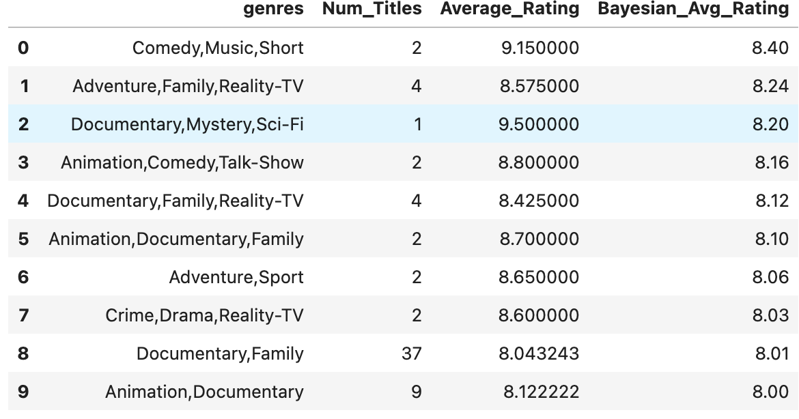
Genre
Which Genre combinations have the highest ratings?
Top Genre: "Comedy, Music, Short" – Avg. Rating: 9.15, Bayesian: 8.4
Highest Avg. Rating: "Documentary, Mystery, Sci-Fi" – 9.5
Balanced Genre: "Animation, Documentary, Family" – Avg. Rating: 8.7, Bayesian: 8.1

Slide 14
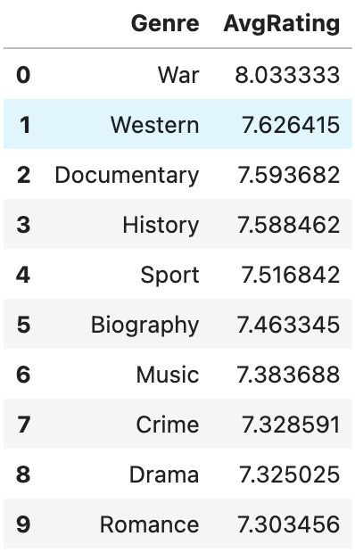
TV Shows
What are the most popular genres in TV Series, TV Mini Series, and TV Episode?
Top Genre: War leads with an average rating of 8.03.
Second Place: Western follows at 7.63.
Other Strong Performers: Documentary (7.59) and History (7.59).

Slide 15
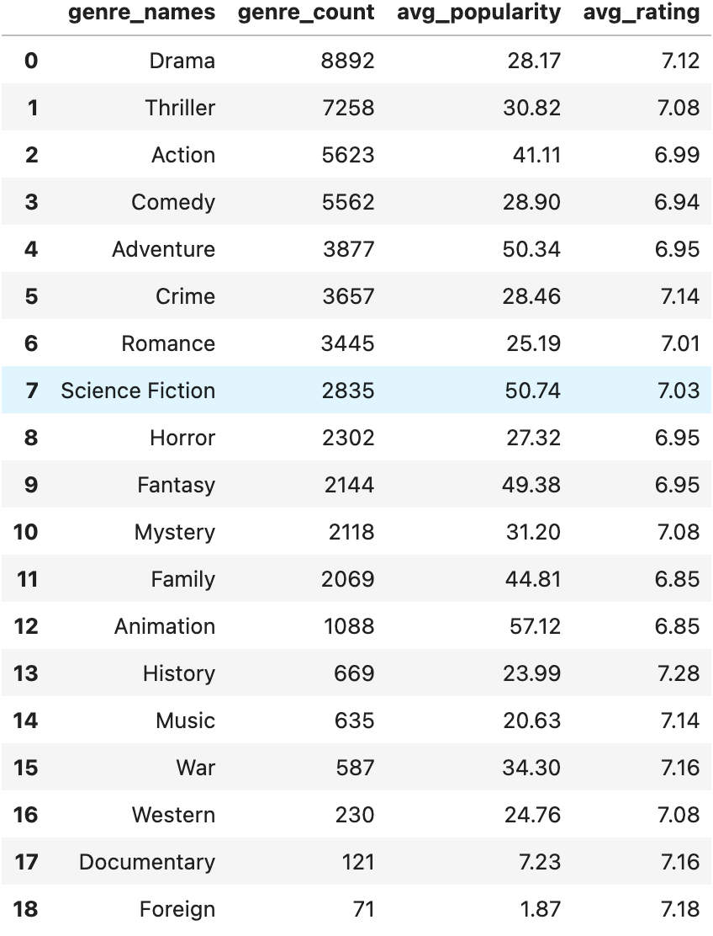
Movie
What are the most popular movie genres and what is their average popularity and average rating?
Drama (7.12), Thriller (7.08), and Action (6.99) are top-rated genres by average rating.
High ratings don’t always align with average popularity, showing a gap between acclaim and audience appeal.

Slide 16
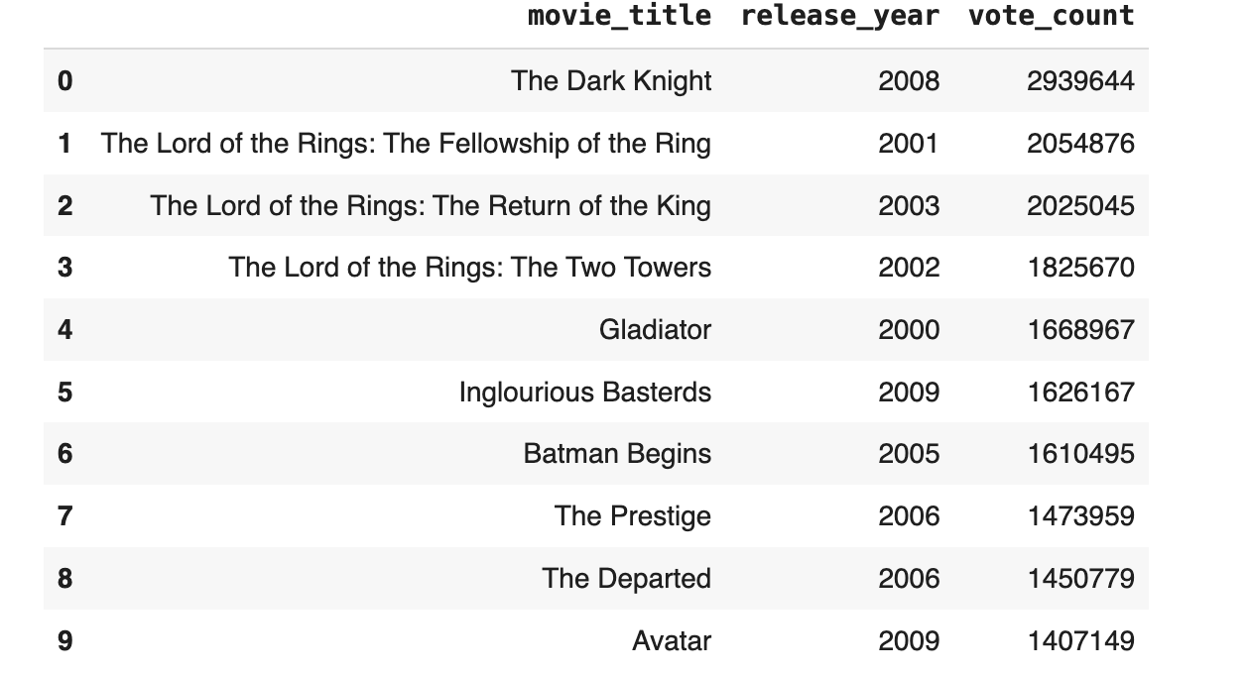
What are the Top 10 Most Popular Movies(by vote count) Released in the 2000s
Top Voted Movies: The Dark Knight (2.94M votes) leads the list, showcasing its immense popularity and impact among audiences.
The Lord of the Rings trilogy dominates with all three movies
Consistently High Performers: Movies like Gladiator (1.67M votes), and Batman Begins (1.61M votes) also rank highly, highlighting their strong audience appeal.

Slide 17
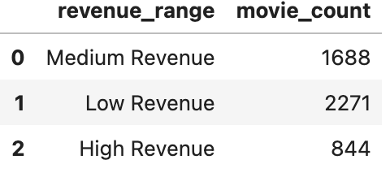
Revenue
What is the categorization of the movies according to the revenue?
Movies are categorized into three revenue ranges using statistical thresholds:
High Revenue: Defined by the 75th percentile and above --- 844.
Medium Revenue: Falls between the median and 75th percentile---1688 .
Low Revenue: Defined by the 25th percentile and below --- 2271.
Most movies perform moderately — opportunity to boost

Slide 18
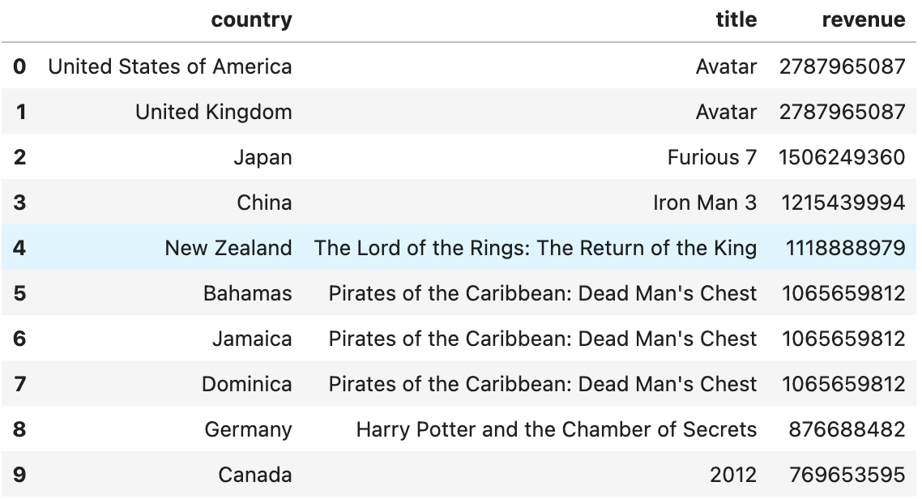
What are the highest revenue generating movie for each country (TOP 10)
Global Blockbusters： Avatar dominates in both US and UK with the highest revenue
Regional Perferences：Pirates of the Caribbean 2 leads in Jamaica, Bahamas and Dominica ---- strong interest in adventure
Localized Success: Iron Man 3 leads in China ($1.2 billion), while Harry Potter and the Chamber of Secrets is the favorite in Germany ($876 million).

Slide 19

Dashboards

Slide 20
04
Conclusion & Challenges

Slide 21



Recommendations
Focus on High-Performing Genres and Themes
Optimize Runtime
Strategic Release Timing
Regional Tailoring
Brand Building
Expanding Global Reach
Notes:
Focus on High-Performing Genres and Themes: Prioritize Action, Adventure, Animation, and popular themes like War and Western; tailor content to regional preferences.
Optimize Runtime: Aim for 1.5–2 hours to meet audience expectations.
Strategic Release Timing: Schedule major releases in June and December to maximize peak viewing periods.
Regional Tailoring: Cater to regional markets, e.g., capitalize on Caribbean successes like Pirates of the Caribbean.
Brand Building: Strengthen studio brands (e.g., Marvel Studios) to drive audience loyalty and consistent revenue.
Expand Global Reach: Invest in regional films (e.g., Indian cinema) to tap into new and growing markets.

Slide 22
Challenges
Missing and Inconsistent Data
Data Format Issues (JSON)
Data Cleaning in SQL

Slide 23
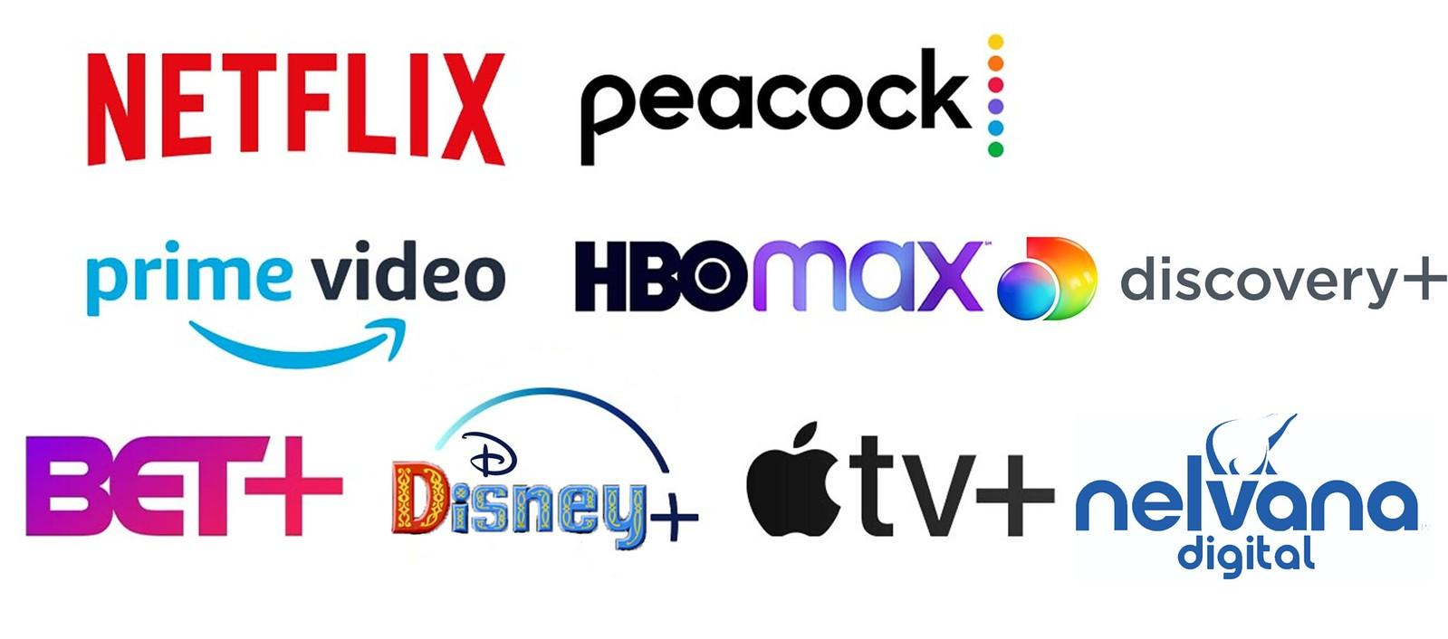
Future Steps
Impact of Streaming Platforms
Star Power and Directorial Influence
Analyse Relationship between Budget Size and Box Office
Evolving Audience Behavior
Notes:
Impact of Streaming Platforms: Analyze the impact of streaming services on traditional movie revenue models and audience behavior.
Star Power and Directorial Influence: Explore how actors, directors, and budgets affect box office success for more refined strategies.
Regional Preferences: Examine variations in audience tastes across regions to better cater to global markets.
Budget Analysis: Study the relationship between budget size and box office success for optimal investment decisions.
Evolving Audience Behavior: Adapt production and distribution strategies to align with changing audience preferences across cinema, TV, and streaming platforms.

Slide 24
References
IMDb Non-Commercial Datasets (https://datasets.imdbws.com/)
Movie Box Office Revenue Prediction (https://data.mendeley.com/datasets/xv9wtc9gdk/2)

Slide 25

Thanks

